Slide 1
Introduction to Oracle ADF Business Components
The Business Service Layer
Introduction to Oracle ADF Business Components

Slide 2
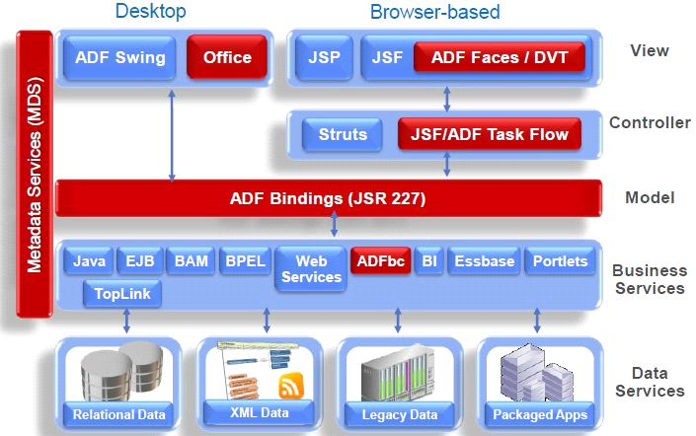
Introduction to Oracle ADF Business Components
The Business Service Layer
Introduction to Oracle ADF Business Components

Slide 3
The Business Service Layer
Overview of ADF Business Components
ADF Business Components is a framework for building Java EE based business services that interact with a database
1
Simplifies Data Access
It simplifies data access and writing business logic on top of data.
2
Declarative Development
Development is mostly declarative through metadata rather than code.
3
Separation of Data Views
Provides separation of data views from business logic and validation.

Slide 4
Artifacts of ADF Business Components
Entity objects represent database tables and allow operations like insert, update, and delete.
Entity objects consist of attributes that map to columns.
Entity Objects
View Objects
Application Model
Represent tables in the database and map to database tables.
Represent queries against data.
Exposes data model for developers to use.
Can be based on single or multiple entity objects.
Controls database connection and transaction management.
Define behaviors and validation for attributes.

Slide 5
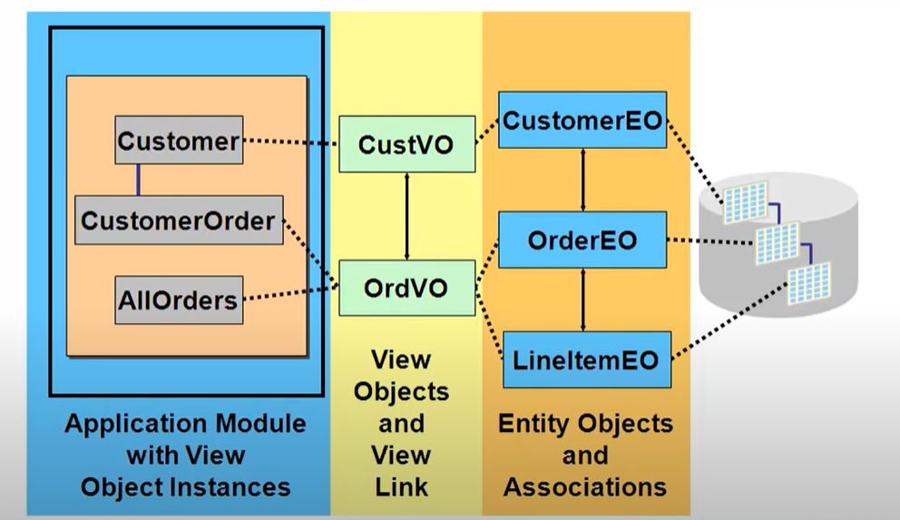
.ADF business components are divided into three layers: entity objects, view objects,
and application model.
•.Entity objects represent database tables and allow operations like insert, update, and delete.
• View objects represent data sets that can be updated or non-updatable.
• The application model exposes the interface for user interface designers and handles
database connection in transaction management.

Slide 6
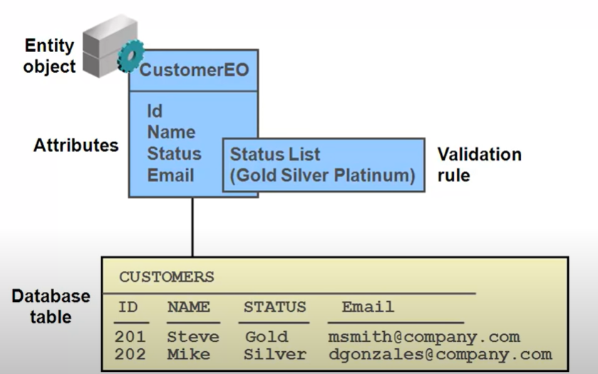
Entity Objects
Represent tables in the database and map to database tables.
Consist of attributes that map to columns.
1
Operations
2
Behaviors
3
Association
Handle insert, update, delete operations against the table.
Define behaviors and validation for attributes.
Association represents relationships between entity objects.

Slide 7
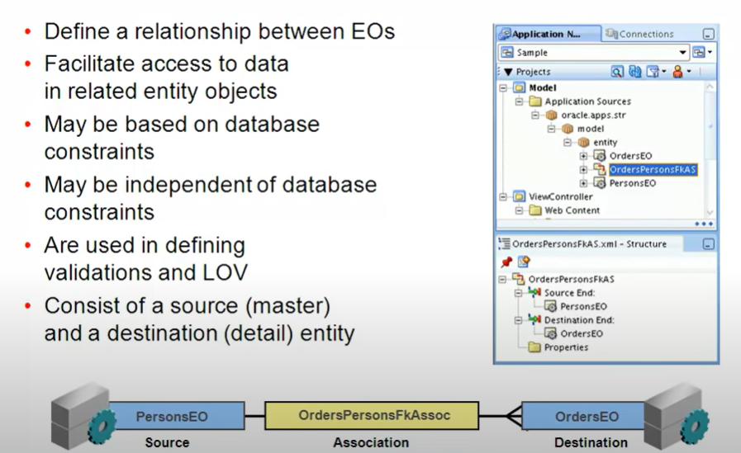
Association
• Represent relationships between entity objects.
• Map to database relationships.
• Can be independent of database relationships.
• Used to access data from one entity to another.

Slide 8
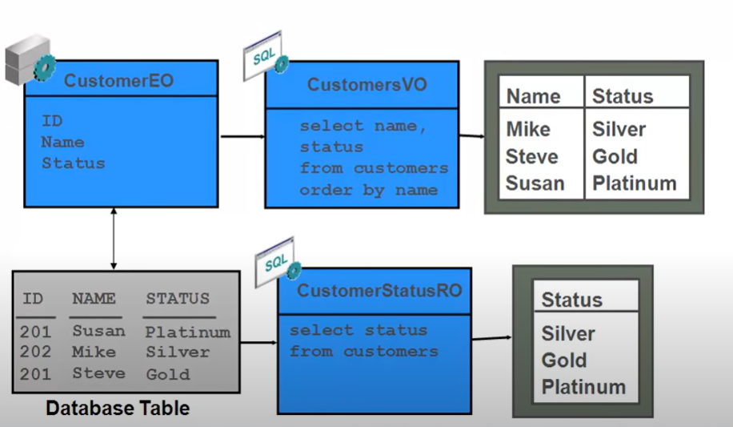
View Objects
- Represent queries against data
- Can be based on single or multiple entity objects
- Can be updatable or non-updatable
- Define specific sets of data through filtering, joining, etc.
Updatability
Data Filtering

Slide 9
Application Model
Exposes data model for developers to use.
Controls database connection and transaction management.
1
2
Data Model
Database Connection
Constructed from view objects, view links, and service methods at the application module level.
Handles database connection and transaction management.

Slide 10



Creating Entity Objects
Represents tables in the database and map to database tables.
Consist of attributes that map to columns.
Insert, Update, Delete
Behaviors and Validation
Association
Handle insert, update, delete operations against the table.
Define behaviors and validation for attributes.
Association represents relationships between entity objects.

